Slide 1
Quorum, Corda and Hyperledger Fabric Comparison
May 2017

Slide 2
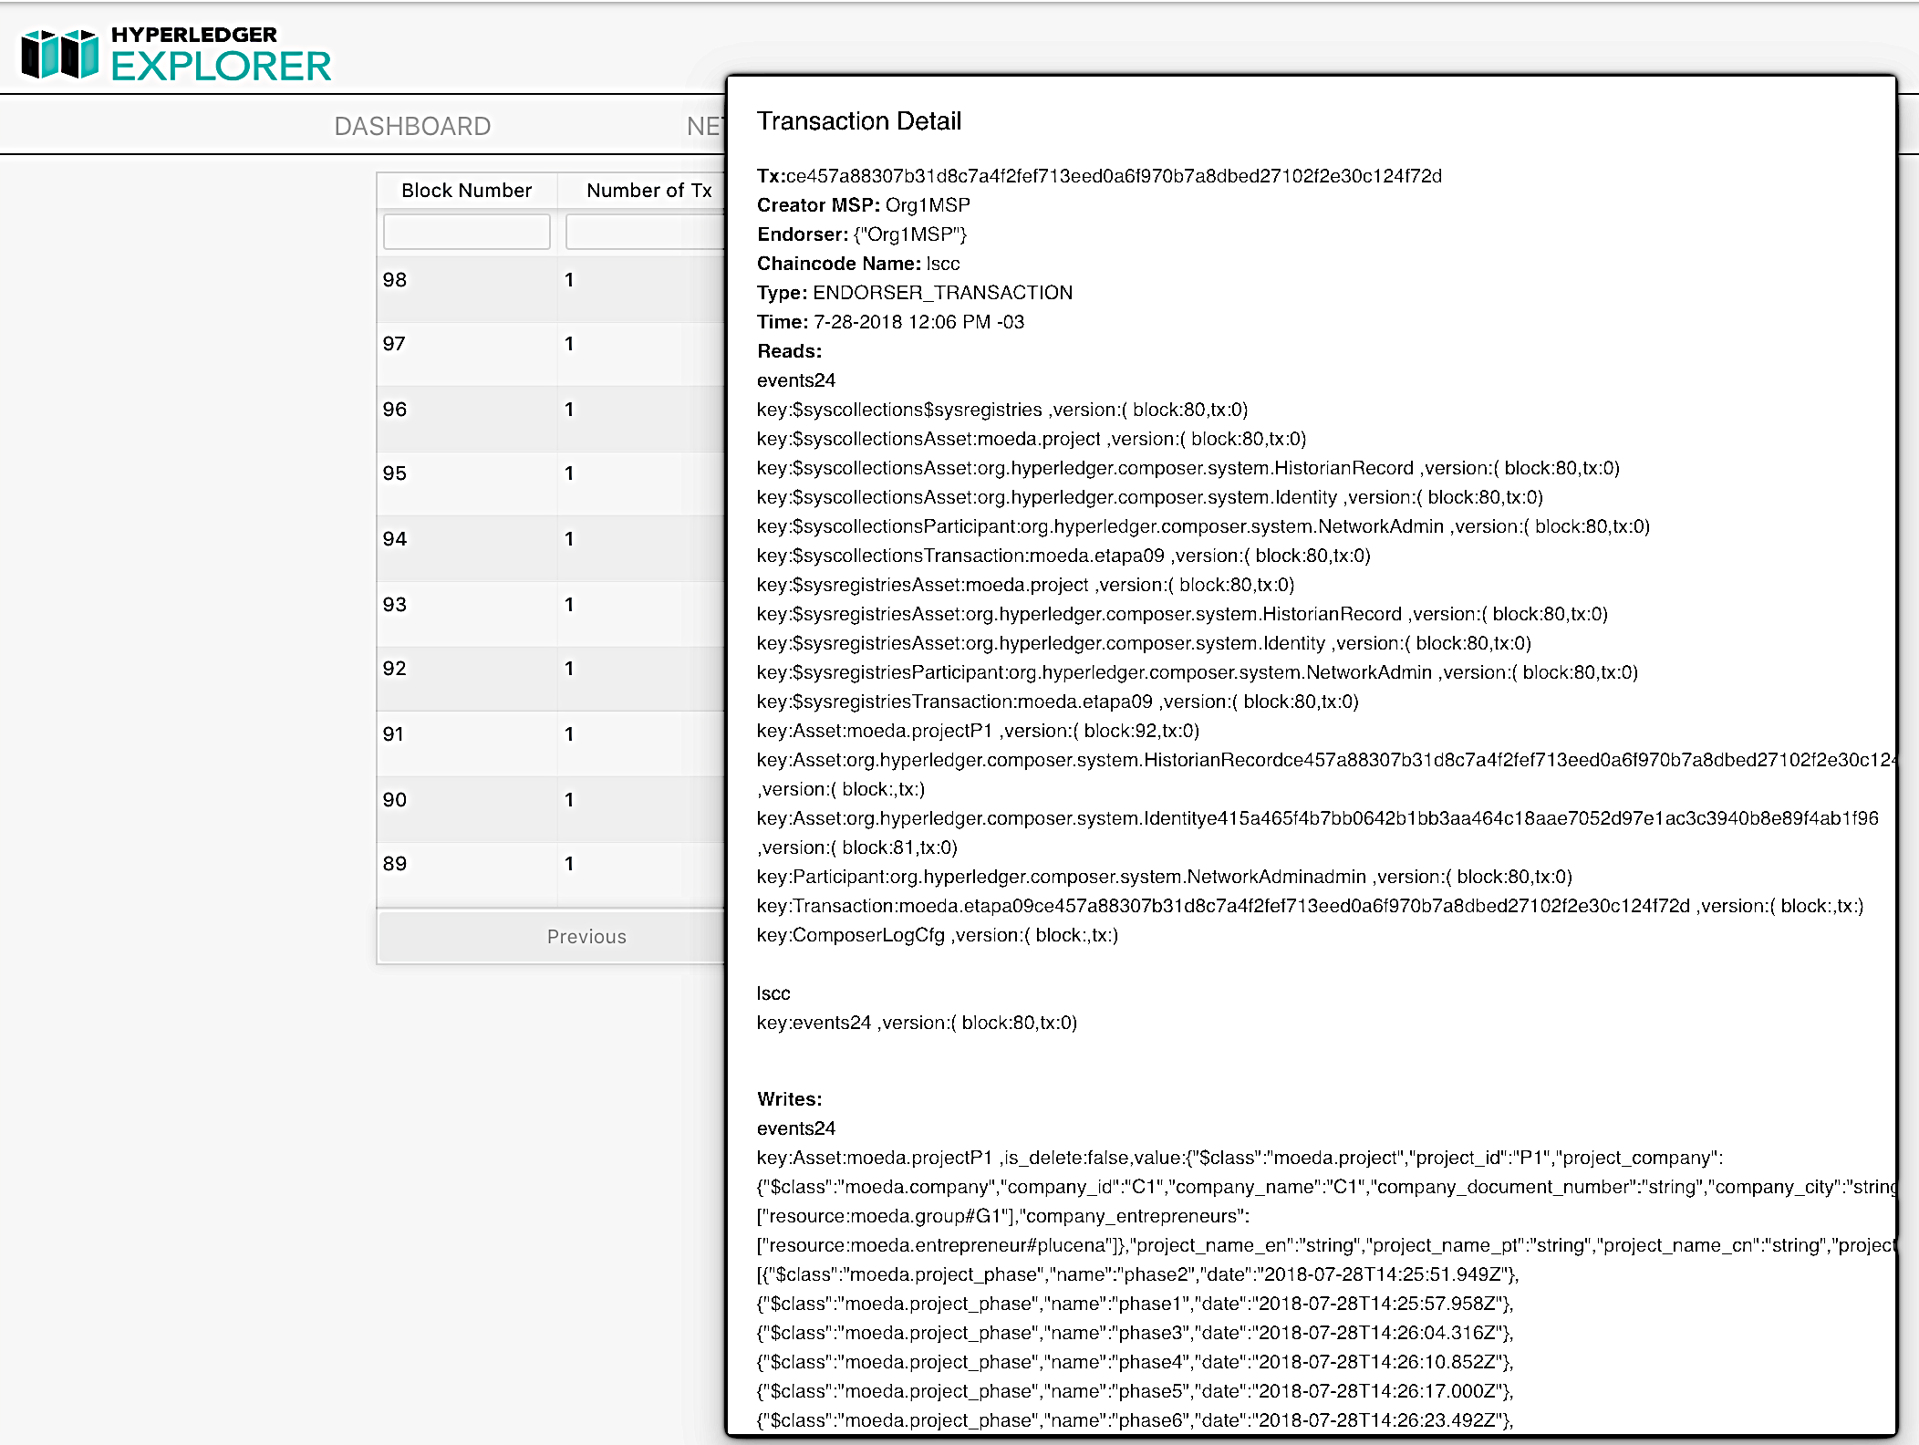

Slide 3
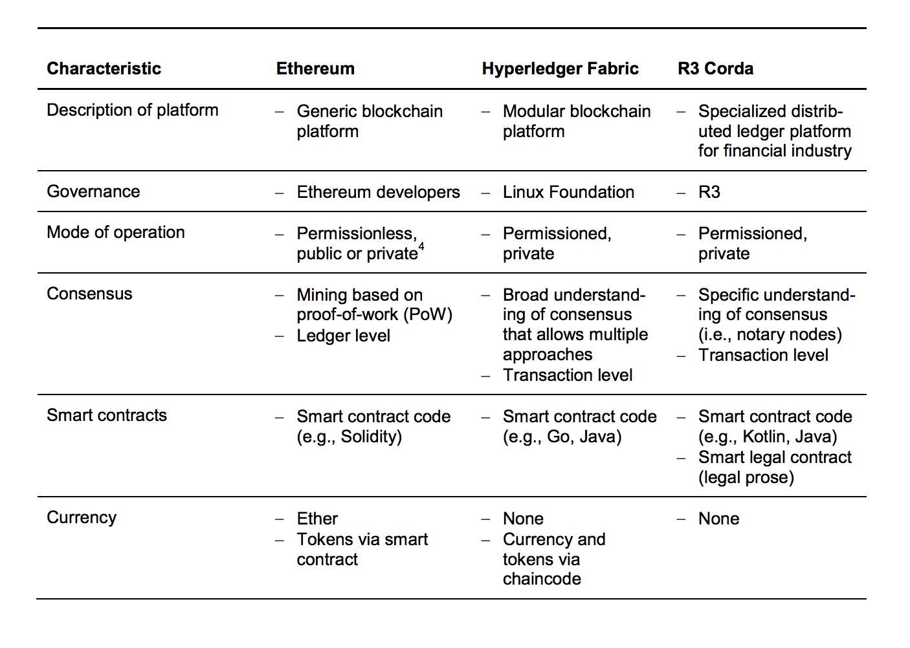
Summary

Slide 4
Consensus – Quorum + Corda
Ethereum: Execução em todos nós – PBFT, PoS Corda – Assinaturas (nós responsaveis P2P) Traditional Blockchain: Order: Corda – Notary Node

Slide 5
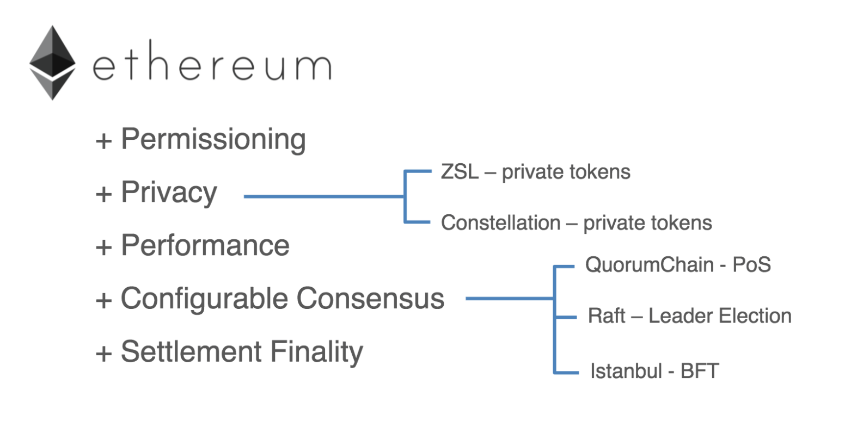
Ethereum Enterprise - Quorum

Slide 6
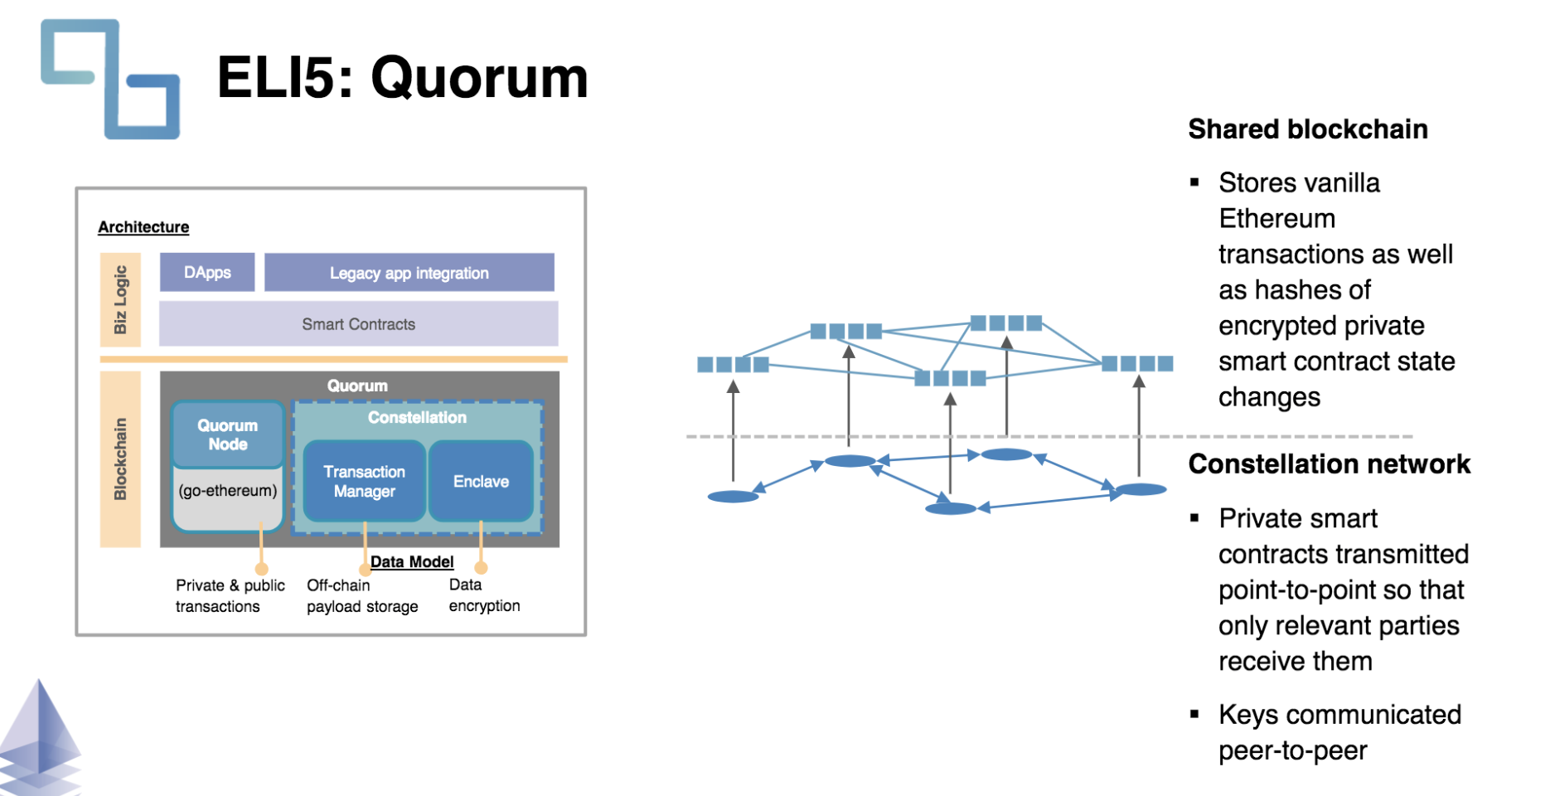
Ethereum Enterprise – Quorum Constellation Networks

Slide 7
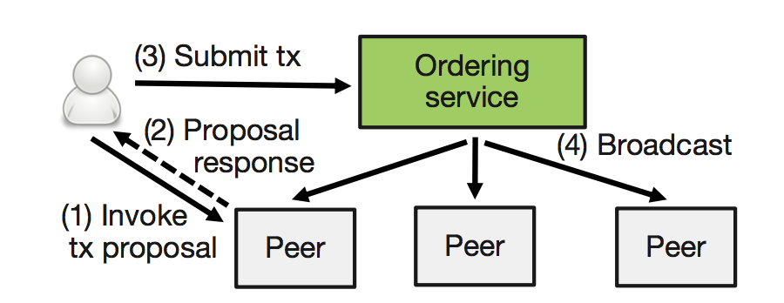
Hyperledger Fabric different approach

Slide 8
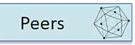
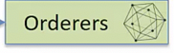
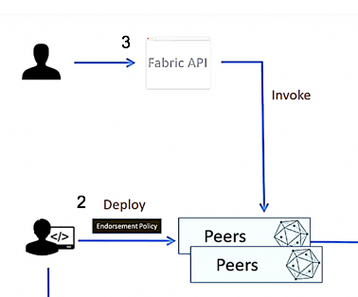

Client chain code invocation
A client invokes chaincode execution

Slide 9
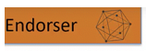
Endorsements
One or more peer per org plays the endorser role. 1- check endorsement policies (signatures)
2 – Executes the smart contract, but does not save the state to the ledger 3 – generates a change proposal with all reads and writes
executed by the chaincode called readset, writset

Slide 10
Client sends endosements
A client sends endorsements to the ordering service

Slide 11
Ordering service
The ordering service establishes the total order of all transactions and broadcasts them as blocks of transactions to all peers in the network.
It uses Apache kafka to propagate transactions to peers

Slide 12
Hyperledger Fabric different approach
When a peer receives a block, it validates every transaction, eliminates those that were based on state that has become invalid

Slide 13
commits valid transactions to its local ledger.

Slide 14
Security
Enterprise blockchain networks require a high degree of security to protect confidential data and proprietary information
Security | Feature | IBM Blockchain | Glossary
 | Permission model | Value: Permissioned platforms restrict privileges for reading, transacting, and participating in consensus to permissioned entities Capability: Implemented through a membership services which provides identities in the form of X.509 certificates. designed to be pluggable | https://hyperledger-fabric.readthedocs.io/en/latest/glossary.html#membership-services
 | Privacy and confidentiality | Value: Identity of participants and transaction data should not be discerned or linkable by other parties Capability: Hyperledger Fabric offers complete transaction isolation and confidentiality through channels Capability: Regulators and auditors can be permissioned to have greater visibility into the network | https://hyperledger-fabric.readthedocs.io/en/latest/glossary.html#channel
 | Runtime isolation | Value: Smart contracts must be executed in isolated environments to protect against subversion of individual contracts, Capability: Each contract runs in its own Docker container, providing complete isolation between contracts
 | Access control | Value: Access to the network must be managed to protect privacy and confidentiality Capability: Hyperledger Fabric provides a framework to easily integrate access controls using the Certificate Authority (CA). The CA provides the necessary certificates to enroll and issue transactions in the network and is designed to be pluggable in order to leverage existing, trusted, certificate authorities | https://hyperledger-fabric.readthedocs.io/en/latest/glossary.html#fabric-ca
 | Resistance to attacks | Value: Production networks must be able to prevent failure from either accidental disruption or malicious action Capability: Hyperledger Fabric provides fault tolerance for both simple server crashes and complex instances of malicious or accidental behavior and collusion (Byzantine Fault Tolerance) Capability: Specification of endorsement policies define the rules for establishing consensus for a specific smart contract | https://hyperledger-fabric.readthedocs.io/en/latest/glossary.html#endorsement-policy
 | High security deployment | Value: Production networks handling critical transaction infrastructure must provide enhanced security capabilities Capability: The High Security Business Network (HSBN) provides hardened security, partitioned execution, high performance, and pre-optimized compute stack Capability: The Secure Service Container feature limits admin access and stores the keys in FIPS 140-2 Level 4 HSM
Notes:
Source: https://hyperledger-fabric.readthedocs.io/en/latest/glossary.html

Slide 15
Scalability
Blockchain networks must be able to scale as the business networks grow, new participants join, and transaction throughput increases
Scalability | Feature | IBM Blockchain | Glossary
 | Throughput | Value: Transaction throughput must be able to scale as networks grow Capability: Although not yet public, Hyperledger Fabric has been able to scale to 1000s of transactions per second Capability: Benchmarking done by independent set of researchers demonstrates a peak throughput of 1273 transactions/sec for Hyperledger Fabric version 0.6 Capability: Throughput likely to be higher given changes for Hyperledger Fabric version 1.0
 | Number of Nodes | Value: Nodes must be created for participants serving specific roles as the network grows Capability: Separate roles of endorsers and committers and the ability to define private subnetworks, business networks can easily scale to thousands of nodes | Endorsement https://hyperledger-fabric.readthedocs.io/en/latest/glossary.html#endorsement Commitment - https://hyperledger-fabric.readthedocs.io/en/latest/glossary.html#commitment
 | Load Distribution | Value: Transaction processing must be distributed among nodes in the network to improve performance and scalability Capability: Hyperledger Fabric defines committers and endorsers as separate roles, allowing expensive operations such as ordering and endorsement to be done by separate nodes, thus improving scalability. Not all nodes endorse every transaction, improving scalability even further | Endorsement https://hyperledger-fabric.readthedocs.io/en/latest/glossary.html#endorsement Commitment - https://hyperledger-fabric.readthedocs.io/en/latest/glossary.html#commitment
 | Number of Networks | Value: Participants will need to participate in multiple private networks depending on the business use-case Capability: A single Hyperledger Fabric node can participate in a large number of networks making the deployment easier to manage for entities that participate in multiple networks. Nodes are able to join multiple channels within the broader blockchain network to participate separately in private transactions. | https://hyperledger-fabric.readthedocs.io/en/latest/glossary.html#channel

Slide 16
Consensus
Blockchain networks must leverage appropriate consensus algorithms in order to establish the necessary trust model for a business network
Consensus | Feature | IBM Blockchain | Glossary
 | Failure Modes | Value: Blockchain networks must have appropriate failure modes to prevent malicious actors or accidents disrupting network performance Capability: Consensus is pluggable and different algorithms can be plugged in to support these failure modes as well as others such as omission failures, timing failures etc. Existing level of trust and sensitivity of the blockchain application, different failure modes are appropriate in different situations.
 | Pluggable Consensus | Value: Existing level of trust and sensitivity of the blockchain application, different failure modes are appropriate in different situations. Since Blockchain technology is quickly evolving, having support for pluggability, makes the platform future proof Capability: Consensus is pluggable and different algorithms can be plugged in to support these failure modes as well as others such as omission failures, timing failures etc. | https://hyperledger-fabric.readthedocs.io/en/latest/glossary.html#consensus
 | Algorithms Available | Value: Business use-cases drive determination of appropriate consensus algorithm Capability: Hyperledger Fabric provides support for pluggable consensus so that multiple failure modes can be supported. Mechanisms supported currently include Apache Kafka based crash fault tolerant consensus, and SBFT/PBFT | https://hyperledger-fabric.readthedocs.io/en/latest/glossary.html#consensus
 | Trust Models | Value: Trust models govern the structure of business networks. Blockchains must reflect these trust models while enabling distributed trust to emerge Capability: Supports specification of unique policies to support required trust models in a network. Permissioned networks can also use the trust in identity provider (membership service) to simplify handling of fault tolerance modes | Membership Services - https://hyperledger-fabric.readthedocs.io/en/latest/glossary.html#membership-services
 | Participation in Consensus | Value: Not all participants need to participate in consensus for permissioned networks Capability: Allows limiting the nodes that need to "sign-off" for a transaction to be considered valid based on the endorsement policy. Supports specification of endorsement policy based on the business use-case | Endorsement policy https://hyperledger-fabric.readthedocs.io/en/latest/glossary.html#endorsement-policy

Slide 17
Developer Support
Developers must have access to a suite of tools and support in order to efficiently develop solutions for tailored blockchain networks
Developer Support | Feature | IBM Blockchain | Glossary
 | Smart Contract Development | Value: Developers require accessible support and tolls for smart contract development Capability: Smart contracts or chaincode are developed using general purpose popular languages (Go-lang and Java), so developers do not need to learn a specialized language. Support for other languages such as python and javascript is being worked on by the community Capability: The Hyperledger Fabric Fabric Client (HFC) SDK provides a powerful and easy to use API to interact with a Hyperledger Fabric Fabric blockchain | https://hyperledger-fabric.readthedocs.io/en/latest/glossary.html#chaincode
 | App Development Support | Value: Developers require accessible support and tolls for smart contract development Capability: SDKs are available both for major platforms such as Node.js, Java, while Python SDK will be available soon Capability: Hyperledger Composer is a suite of high level application abstractions for business networks, it emphasizes on business centric vocabulary for quick solution creation | https://hyperledger.github.io/composer/
 | Model Driven App Development | Value: Development must be driven to digitally model business networks Capability: Hyperledger Composer allows non-programmers to easily create applications, and define the roles of each participant in a network Capability: Smart contracts can be developed to fit the specific network using a modeling language to map complex business networks for a blockchain application including users, assets, and transactions | https://hyperledger.github.io/composer/
 | PaaS Support | Value: Enterprise support for production blockchains will likely be operated as a service Capability: IBM Blockchain on Bluemix is a managed service for Hyperledger Fabric, making it fast and easy to build, run and govern business networks while ensuring high levels of security, privacy, and performance. New networks can be bootstrapped by setting up governance rules, inviting members, and configuring network policies. Operators can use dashboards and governance tooling to run and maintain the network. Subscriptions include free starter plans and paid plans for High Security Business Networks based deployments. | https://www.hyperledger.org/
 | Community / Ecosystem | Value: Community support for open-source technologies depends on well defined governance models Capability: The Linux Foundation's Hyperledger Project now includes over 120 members from a wide range of industries, including service providers, start-ups, industry incumbents, and regulator Capability: Developers participate in community forums (RocketChat), meet-ups, and list serves, providing a reliable source for technical support and open-source development | https://www.hyperledger.org/

Slide 18
Data Layer
Blockchain networks should leverage adaptable database capabilities to improve data management and analytics support
Data Layer | Feature | IBM Blockchain | Glossary
 | Supported Databases | Value: Enterprises leverage a wide range of data bases with existing capabilties Capability: Supports database pluggability. Default implementation uses embedded key/value using LevelDB, supporing keyed queries within the database. Provides support for Apache CouchDB, allowing full query support on key and value, and meets requirements on a range of chaincode, auditing, and reporting requirements | https://hyperledger-fabric.readthedocs.io/en/latest/glossary.html#state-database
 | Types of Queries | Value: Queries enable basic data management and enhanced analytics capabilities Capability: 1) LevelDB has, by default, a key value database and supports keyed queries, composite key queries, and key range queries 2) Complex, rich queries, CouchDB supports the basic capabilities of LevelDB, and adds the full data-rich queries 3) Working towards supporting cross-channel Query by June | https://hyperledger-fabric.readthedocs.io/en/latest/glossary.html#state-database
 | Support for Custom Events | Value: Participants in a network must be notified of relevant events Capability: Applications can register to be notified when transactions succeed or fail, and when blocks are added to the ledger. Applications will also be notified of each peer to which they are connected. Hyperledger Fabric has the ability to allow smart contracts to emit custom events | https://hyperledger-fabric.readthedocs.io/en/latest/glossary.html#software-development-kit-sdk
 | Analytics Support | Value: Organizations look to blockchains as a means of enhancing their analytics capabilities Capability: CouchDB has readily available connectors to various other data stores and analytics engines including Spark, Hadoop, elastic search, and relational data stores such as dashDB, DB2 and postgres Capability: Current plans will support reporting and analytics via data replication to an analytics engine Capability: Hyperledger Composer supports interaction with external analytics platforms | https://hyperledger-fabric.readthedocs.io/en/latest/glossary.html#state-database

Slide 19
Pluggability
Blockchain networks must be able to adapt to and incorporate a wide range of ”pluggable” features to build tailored blockchain networks
Pluggability | Feature | IBM Blockchain | Glossary
 | Consensus Algorithm | Designed to be pluggable Currently, implementations for consensus based on Apache Kafka and SBFT are available | https://hyperledger-fabric.readthedocs.io/en/latest/glossary.html#consensus
 | Ledger Database | Designed to be pluggable State database options include LevelDB and CouchDB (beta) for the time being, with other options under development | https://hyperledger-fabric.readthedocs.io/en/latest/glossary.html#state-database
 | Cryptographic Libraries | Designed to be pluggable Membership Service Provider is designed with base X.509 cryptography, but supports pluggability of different types Policies for cryptography can be changed through channel configuration, or through the chaincode itself. | https://hyperledger-fabric.readthedocs.io/en/latest/glossary.html#membership-service-provider
 | Membership Service | Designed to be pluggable, supporting the concept of “bring your own identity” Membership model is decentralized allowing identity services from different organizations to be plugged in with potentially multiple roots of trust A deployment can use the default CA implementation provided, plug in their own CA, or replace only some portion of the default implementation | https://hyperledger-fabric.readthedocs.io/en/latest/glossary.html#fabric-ca
 | P2P Protocols | Gossip protocol used for communication between peer nodes is itself pluggable Allows using off the shelf implementations as well swapping protocols with more efficient versions as technology evolves | https://hyperledger-fabric.readthedocs.io/en/latest/glossary.html#gossip-protocol

